Slide 1
Ƒ Randomized Data Within Nest Watch
Original Data 1:
Real data
Original data
Randomized data
Ƒ Randomize Among Nest Watch Within Individual Same Provisioning Rate
Ƒ Summarise Data per visit rate difference
Ƒ Summarise randomized Data per visit rate difference
Ƒ Plot
Ƒ Scale Data
Ƒ Randomized Data Within Nest Watch
Original Data 2: Simulated randomized data
Scaled data
Sd Sex = 0 then 1
Randomized Scaled data
Sd Sex = 0 then 1
Original Data 3: Simulated gamma data
Ƒ Average across both standardizing sex
Ƒ Join all Alternation Values from both standardizing sexes
Ƒ Joined
Plot
Ƒ Summarise Data per visit rate difference
Ƒ Summarise randomized Data per visit rate difference
Ƒ Plot

Slide 2
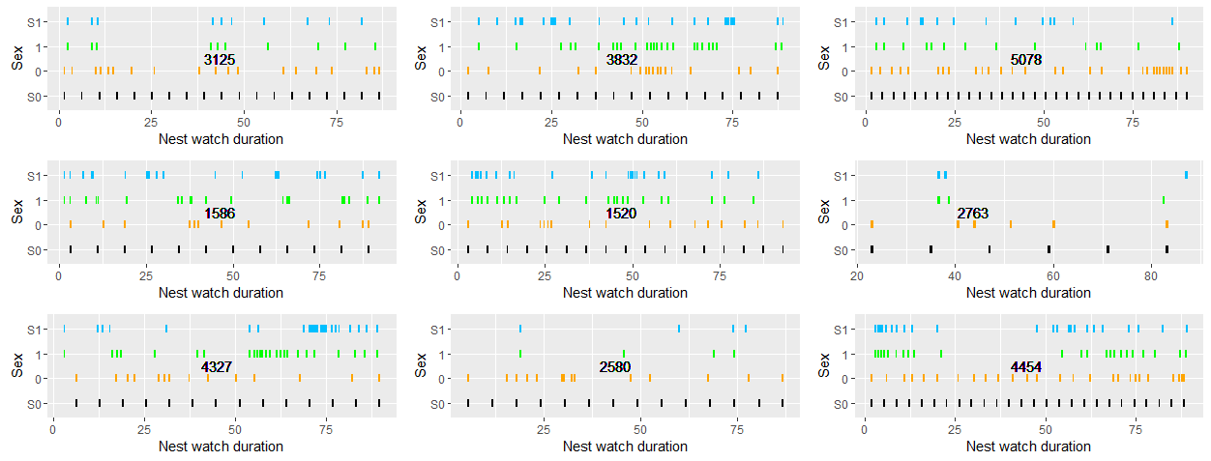
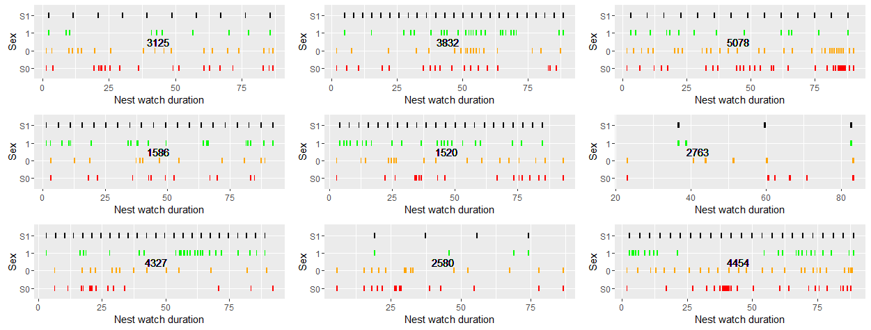

Slide 3
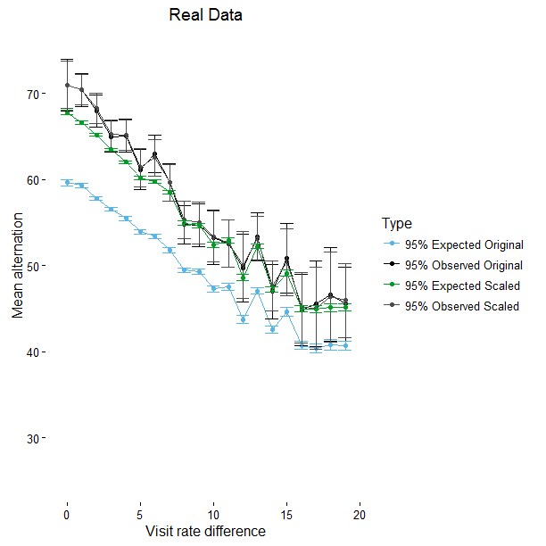

Slide 4
